Slide 1

DATA STRUCTURES AND ALGORITHMS (113215)
Dr. Owais Hussain

Slide 2

Agenda
Arrays
Representation in memory
Array operations:
Inserting
Traversing
Deleting
More… Search, Split, Merge
Multi-dimensional arrays
Record Keeping using Arrays

Slide 3
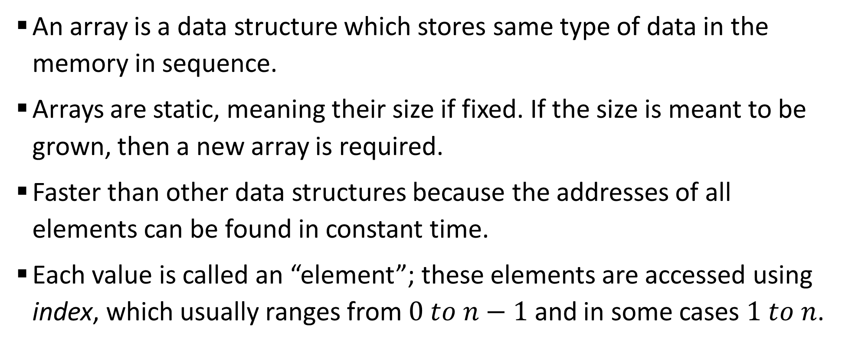
Sample 2
Arrays
An array is a data structure which stores same type of data in the memory in sequence.
Arrays are static, meaning their size if fixed. If the size is meant to be grown, then a new array is required.
Faster than other data structures because the addresses of all elements can be found in constant time.
Each value is called an “element”; these elements are accessed using index, which usually ranges from $0 to n−1$ and in some cases $1 to n$.

Slide 4
Sample 2
Representation in memory
In computer memory, every piece of data is stored in bits on memory locations.
Consider KIET’s North campus as memory. The campus is organized in rooms and each room has seats.
Rooms are already numbered, but if you also assign a number to each seat, you will have a structure similar to computer memory.

Slide 5
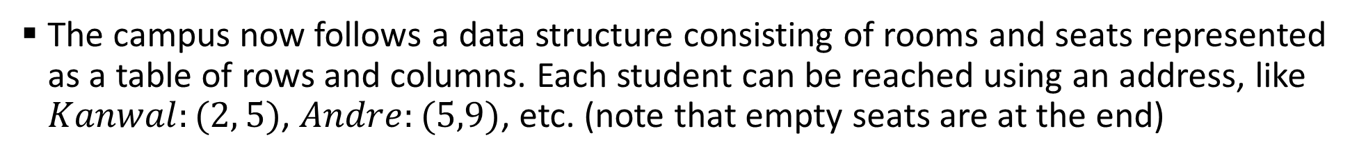
Sample 2
Representation in memory
The campus now follows a data structure consisting of rooms and seats represented as a table of rows and columns. Each student can be reached using an address, like $Kanwal:(2, 5)$, $Andre:(5,9)$, etc. (note that empty seats are at the end)
 | ROOM
Seat | 1 | 2 | 3 | 4 | 5 | 6 | 7 | 8
1 | Ali | Sidra | Parkash | Azfar | Shahid | Owais | Rafeeq | Nabeeel
2 | Haseeb | Ashfaq | Ayesha | Moiz | Hamza | Hira | Umair | Ahmed
3 | Nabeel | Uzair | Khalid | Maimoona | Humdiya | Shakeeb | Abdullah | Babar
4 | Irtiza | Shamsher | Iqbal | Seema | Mughees | Irfan | Asifa | Haris
5 | Wasim | Kanwal | Saqib | Joseph | Shariq | Adnan | Sadeeqa | Amjad
6 | Robia | Haris | Daniyal | Khurram | Shujaat | Sumeet | Naseem
7 | Talha | Shahzeb | Hareem | Ather | Affan | Tahira | Tahir
8 |  | Noman | Jehan | Safwan | Omar |  | Rabia
9 |  | Waqas |  | Sana | Andre |  | Tariq
10 |  | Sajida

Slide 6
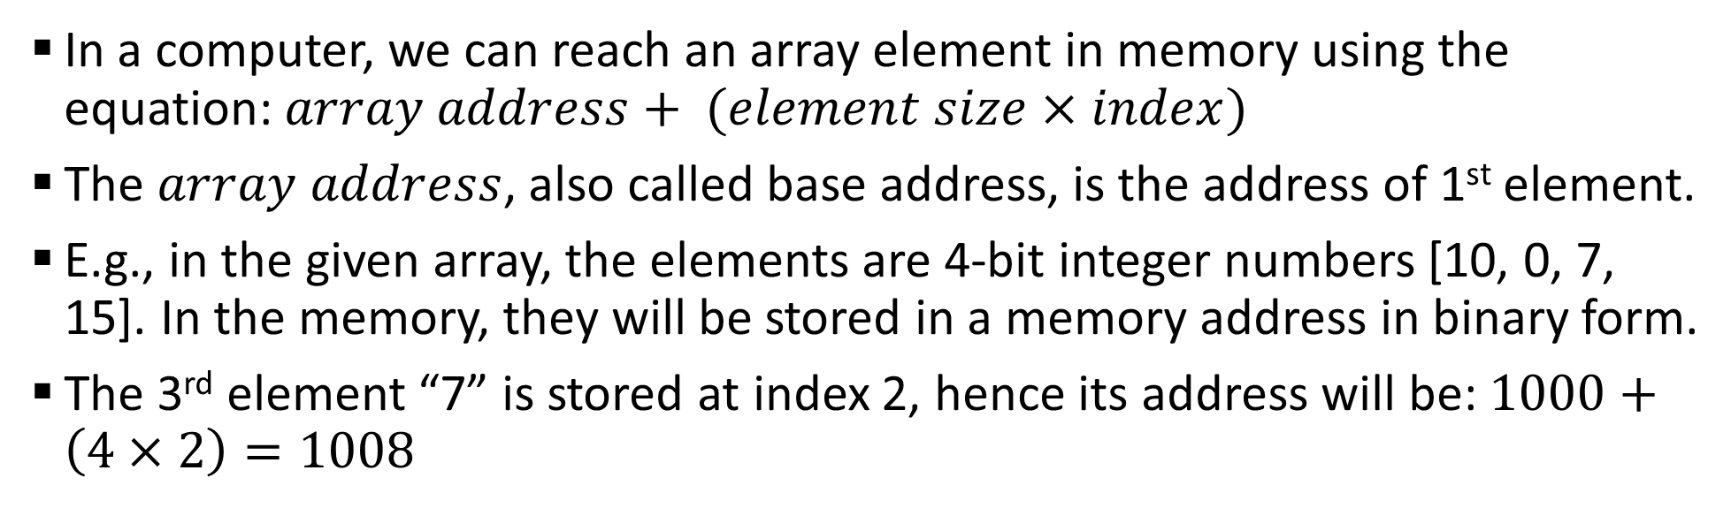
Sample 2
Representation in memory
In a computer, we can reach an array element in memory using the equation: $array address+ (element size×index)$
The $array address$, also called base address, is the address of 1st element.
E.g., in the given array, the elements are 4-bit integer numbers [10, 0, 7, 15]. In the memory, they will be stored in a memory address in binary form.
The 3rd element “7” is stored at index 2, hence its address will be: $1000+\left(4×2\right)=1008$
Address | 1000 | 1001 | 1002 | 1003 | 1004 | 1005 | 1006 | 1007 | 1008 | 1009 | 1010 | 1011 | 1012 | 1013 | 1014 | 1015
Data | 10 |  |  |  | 0 |  |  |  | 7 |  |  |  | 15
Index | 0 |  |  |  | 1 |  |  |  | 2 |  |  |  | 3
Binary | 1 | 0 | 1 | 0 | 0 | 0 | 0 | 0 | 0 | 1 | 1 | 1 | 1 | 1 | 1 | 1

Slide 7
Sample 2
Array operations – Traversing
Traversing is the operation of going through whole array from first index to last.
In some cases, we do not traverse the entire array but from a start to an end position.
The objective of traversing an array is to travel from one position to another linearly, without skipping any elements in between.

Slide 8
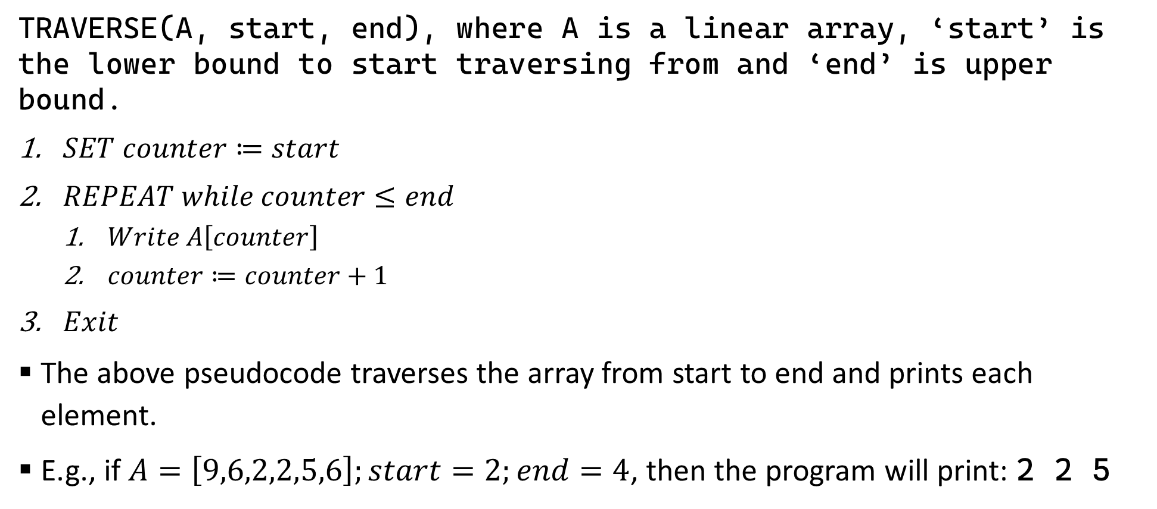
Sample 2
Array operations – Traversing
TRAVERSE(A, start, end), where A is a linear array, ‘start’ is the lower bound to start traversing from and ‘end’ is upper bound.
$SET counter≔start$
$REPEAT while counter≤end$
$Write A\left[counter\right]$
$counter≔counter+1$
$Exit$
The above pseudocode traverses the array from start to end and prints each element.
E.g., if $A=\left[9,6,2,2,5,6\right];start=2;end=4$, then the program will print: 2 2 5

Slide 9
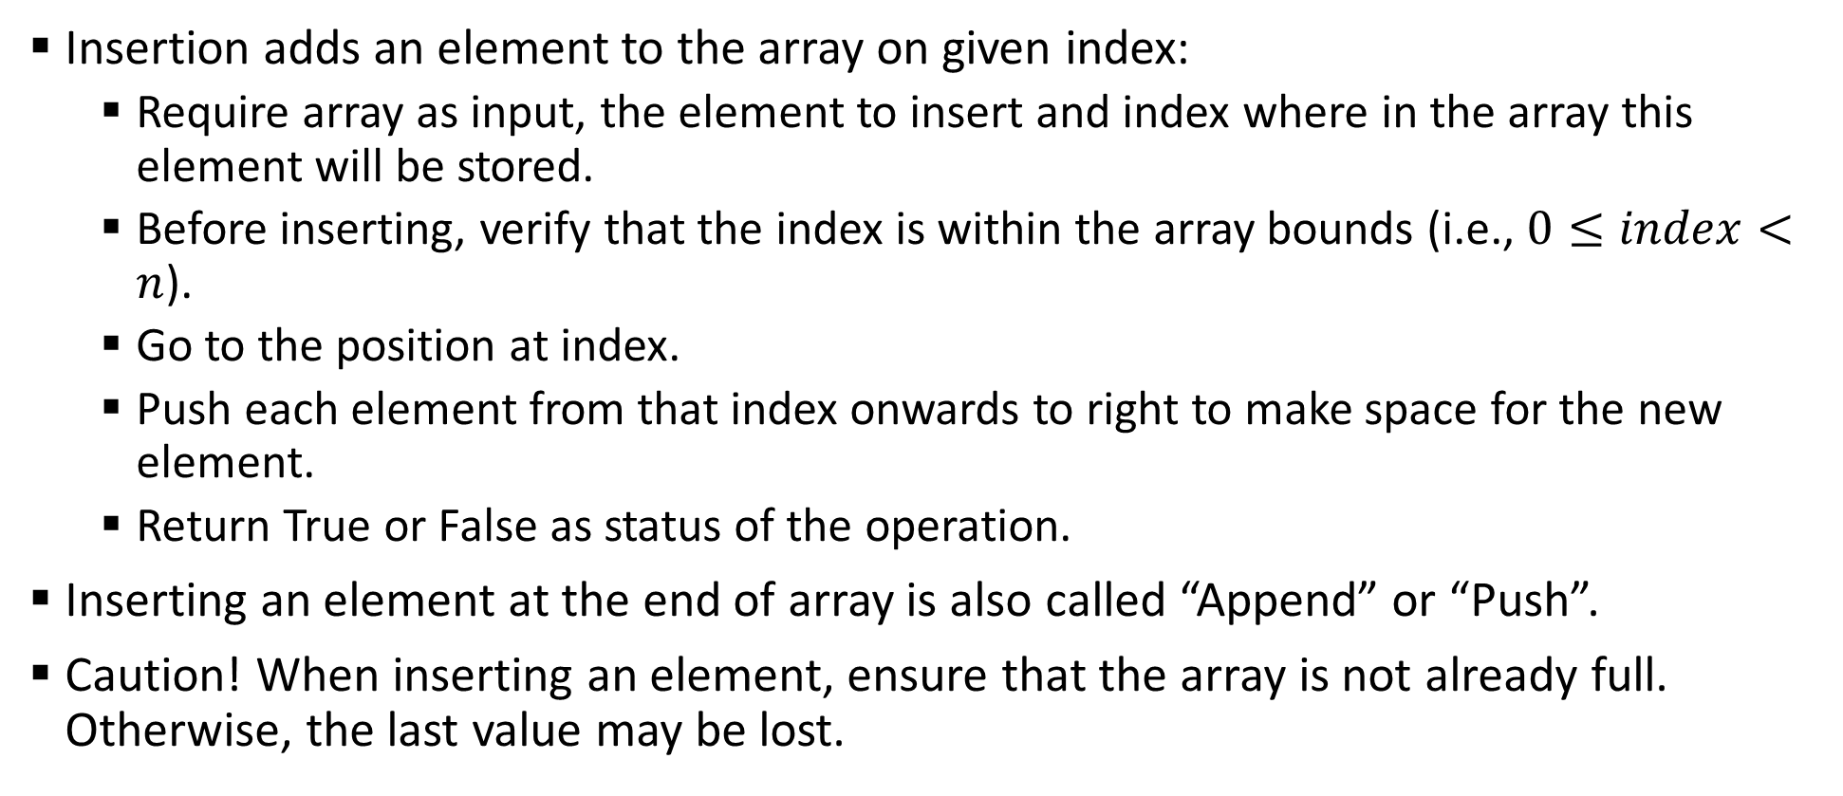
Sample 2
Array operations – Insertion
Insertion adds an element to the array on given index:
Require array as input, the element to insert and index where in the array this element will be stored.
Before inserting, verify that the index is within the array bounds (i.e., $0≤index<n$).
Go to the position at index.
Push each element from that index onwards to right to make space for the new element.
Return True or False as status of the operation.
Inserting an element at the end of array is also called “Append” or “Push”.
Caution! When inserting an element, ensure that the array is not already full. Otherwise, the last value may be lost.

Slide 10
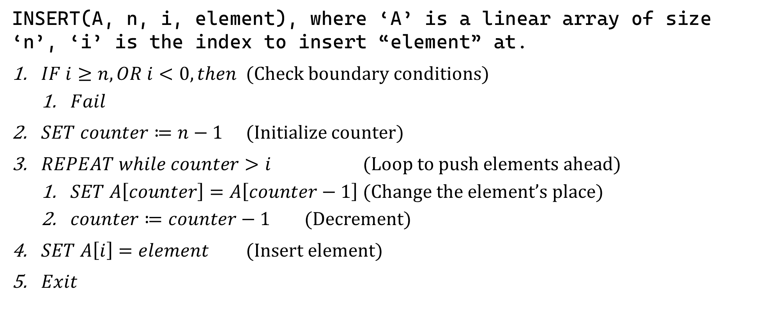
Sample 2
Array operations – Insertion
INSERT(A, n, i, element), where ‘A’ is a linear array of size ‘n’, ‘i’ is the index to insert “element” at.
$IF i≥n, OR i<0, then$ (Check boundary conditions)
$Fail$
$SET counter≔n−1$ (Initialize counter)
$REPEAT while counter>i$ (Loop to push elements ahead)
$SET A\left[counter\right]=A\left[counter−1\right]$ (Change the element’s place)
$counter≔counter−1$ (Decrement)
$SET A\left[i\right]=element$ (Insert element)
$Exit$

Slide 11
Sample 2
Array operations – Insertion
Simulation of Insert operation on an Array. Element 4 is being inserted at index 3.

Slide 12
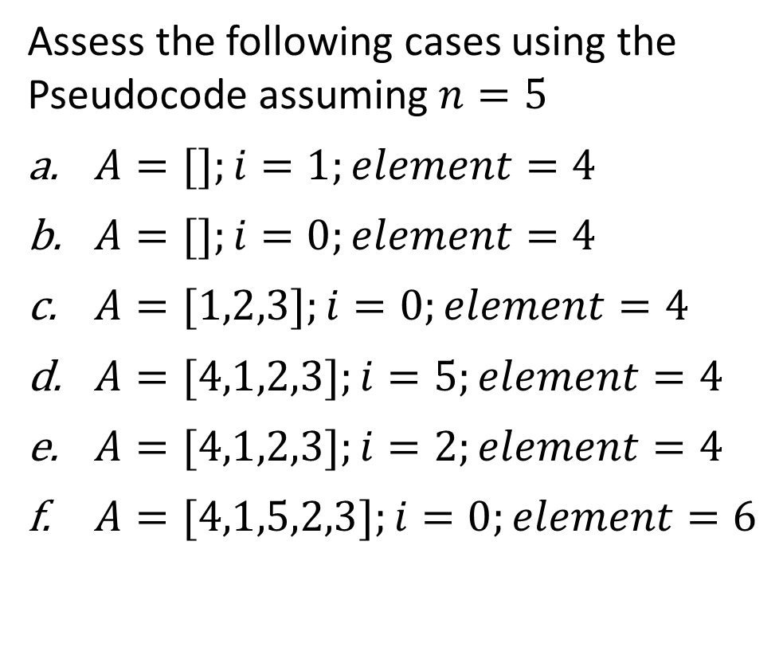
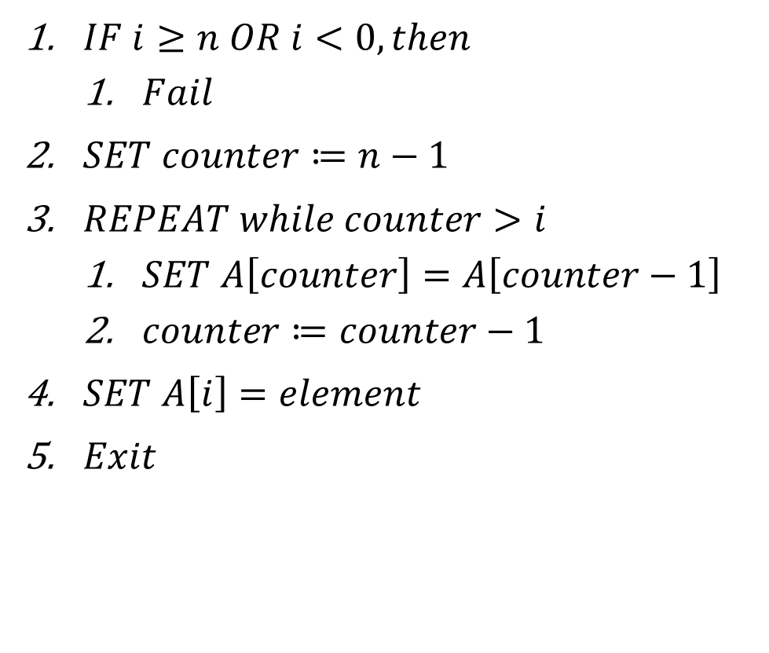
Sample 2
Exercise
Assess the following cases using the Pseudocode assuming $n=5$
$A=[];i=1;element=4$
$A=[];i=0;element=4$
$A=[1,2,3];i=0;element=4$
$A=[4,1,2,3];i=5;element=4$
$A=[4,1,2,3];i=2;element=4$
$A=[4,1,5,2,3];i=0;element=6$
$IF i≥n OR i<0, then$
$Fail$
$SET counter≔n−1$
$REPEAT while counter>i$
$SET A\left[counter\right]=A\left[counter−1\right]$
$counter≔counter−1$
$SET A\left[i\right]=element$
$Exit$

Slide 13
Sample 2
Array operations – Deletion
Removes an element:
Requires array as input and index of the element to remove.
Check that the array is not null and that the index provided is within the array size.
If this is the last element in the array, then set its value to Nil.
Otherwise, push back all other elements 1 step towards left. (This step ensures that the new element always inserts at the end)
Return True or False as status of the operation.

Slide 14
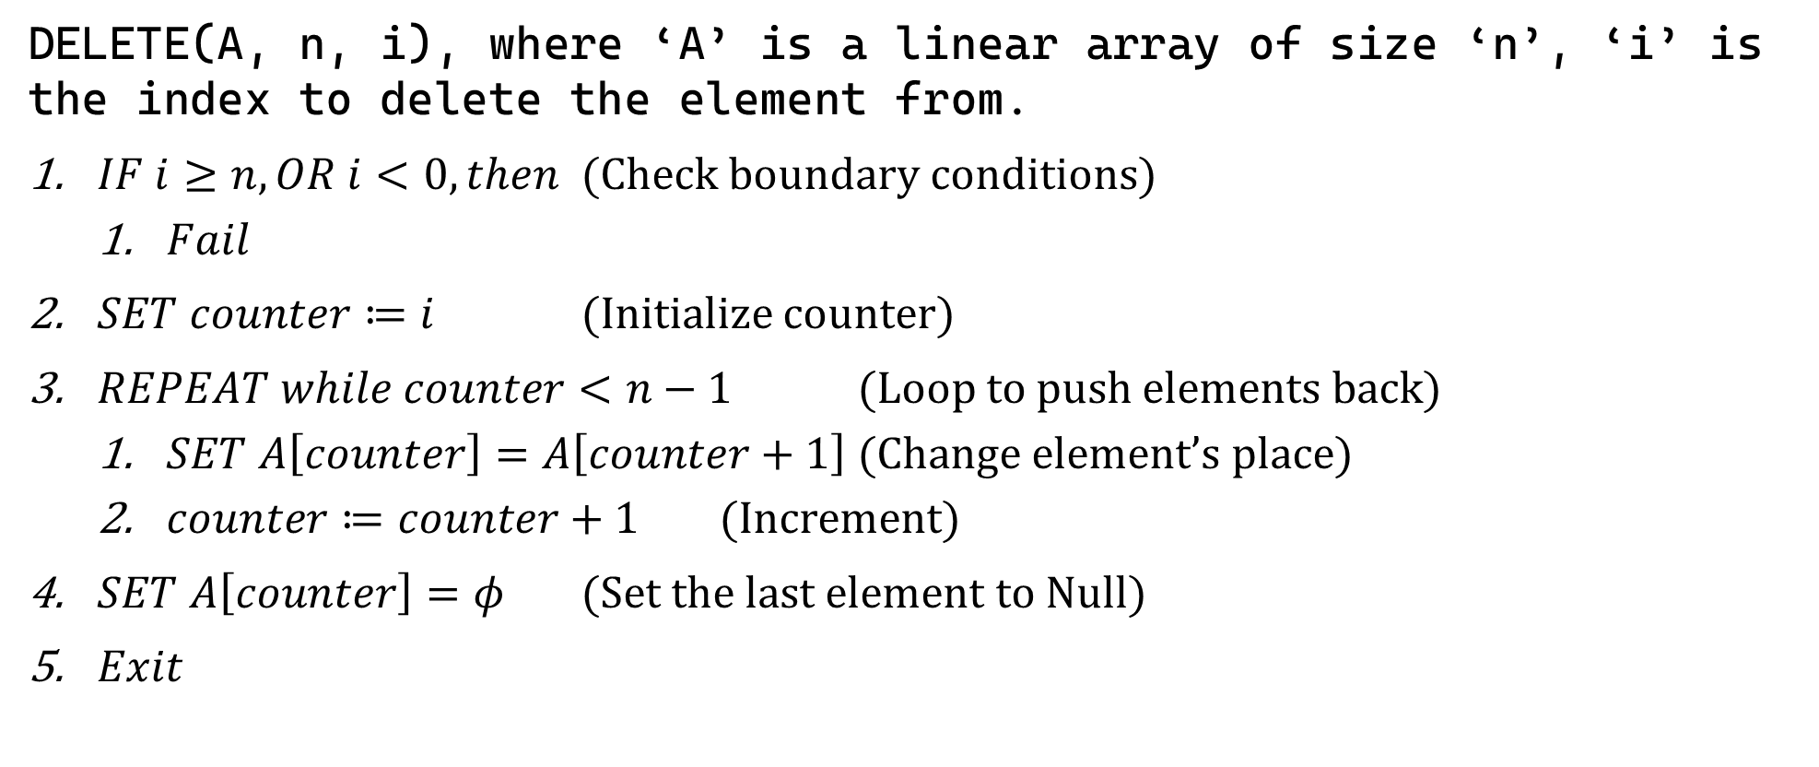
Sample 2
Array operations – Deletion
DELETE(A, n, i), where ‘A’ is a linear array of size ‘n’, ‘i’ is the index to delete the element from.
$IF i≥n, OR i<0, then$ (Check boundary conditions)
$Fail$
$SET counter≔i$ (Initialize counter)
$REPEAT while counter<n−1$ (Loop to push elements back)
$SET A\left[counter\right]=A\left[counter+1\right]$ (Change element’s place)
$counter≔counter+1$ (Increment)
$SET A\left[counter\right]=φ$ (Set the last element to Null)
$Exit$

Slide 15
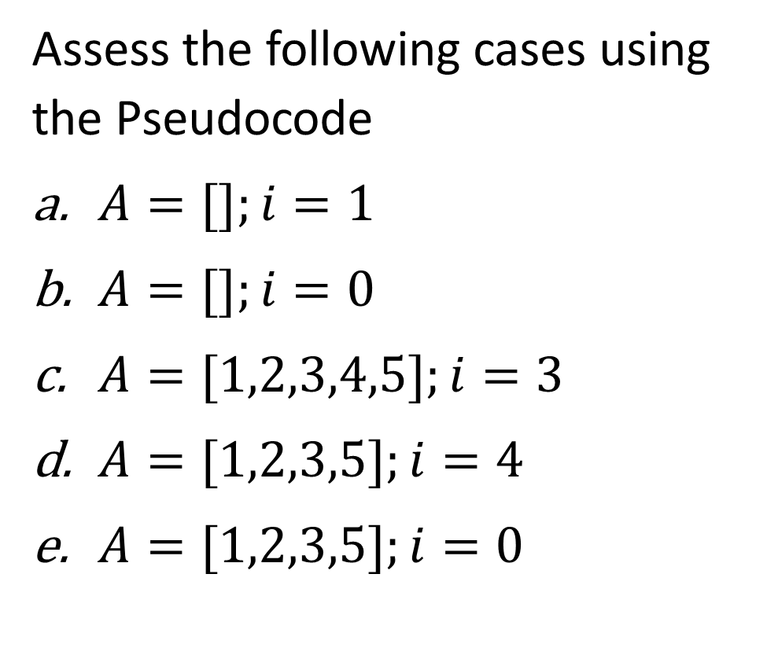
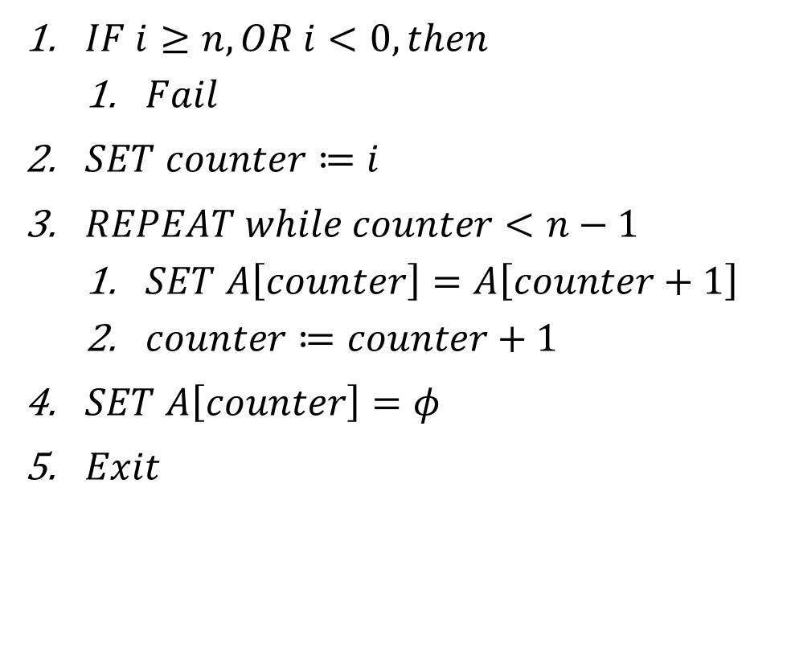
Sample 2
Array operations – Deletion
Assess the following cases using the Pseudocode
$A=[];i=1$
$A=[];i=0$
$A=[1,2,3,4,5];i=3$
$A=[1,2,3,5];i=4$
$A=[1,2,3,5];i=0$
$IF i≥n, OR i<0, then$
$Fail$
$SET counter≔i$
$REPEAT while counter<n−1$
$SET A\left[counter\right]=A\left[counter+1\right]$
$counter≔counter+1$
$SET A\left[counter\right]=φ$
$Exit$

Slide 16
Sample 2
Array operations – Search
Search is similar to Traversing, but the difference is that search always returns something, secondly it may not traverse whole array.
For example, if we are searching for an element, then the traversing will stop once that element is found.
However, if we are interested in finding maximum value in the array, then the entire array will be traversed.
Search operation can be performed to find an element, a set of elements, or an aggregation (e.g., sum or product) of elements.

Slide 17
Sample 2
Array operations – Search
Some examples of search can be:
Find a student by SID.
Find the student with lowest or highest GPA in class.
Count the number of male students.
Get all students who have GPA 3.0 or higher.
Search operation may take additional input parameters depending on how they are implemented.

Slide 18
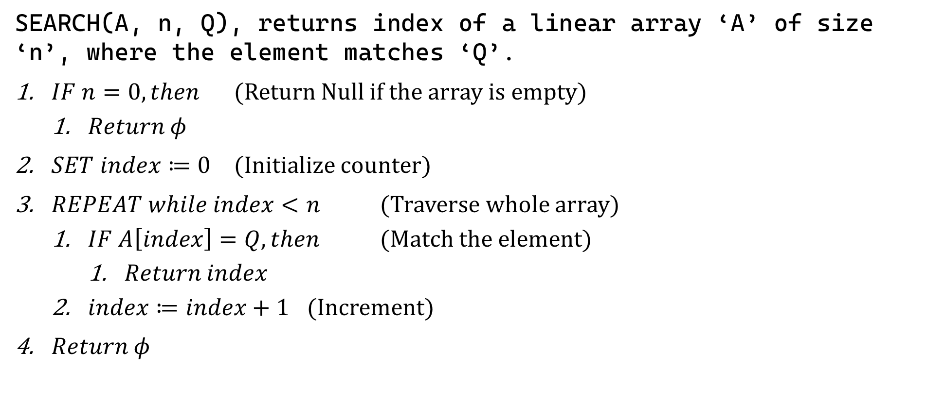
Sample 2
Array operations – Search for an Element’s index
SEARCH(A, n, Q), returns index of a linear array ‘A’ of size ‘n’, where the element matches ‘Q’.
$IF n=0, then$ (Return Null if the array is empty)
$Return φ$
$SET index≔0$ (Initialize counter)
$REPEAT while index<n$ (Traverse whole array)
$IF A\left[index\right]=Q, then$ (Match the element)
$Return index$
$index≔index+1$ (Increment)
$Return φ$
Notes:
Demonstrate how to search for a student by SID

Slide 19
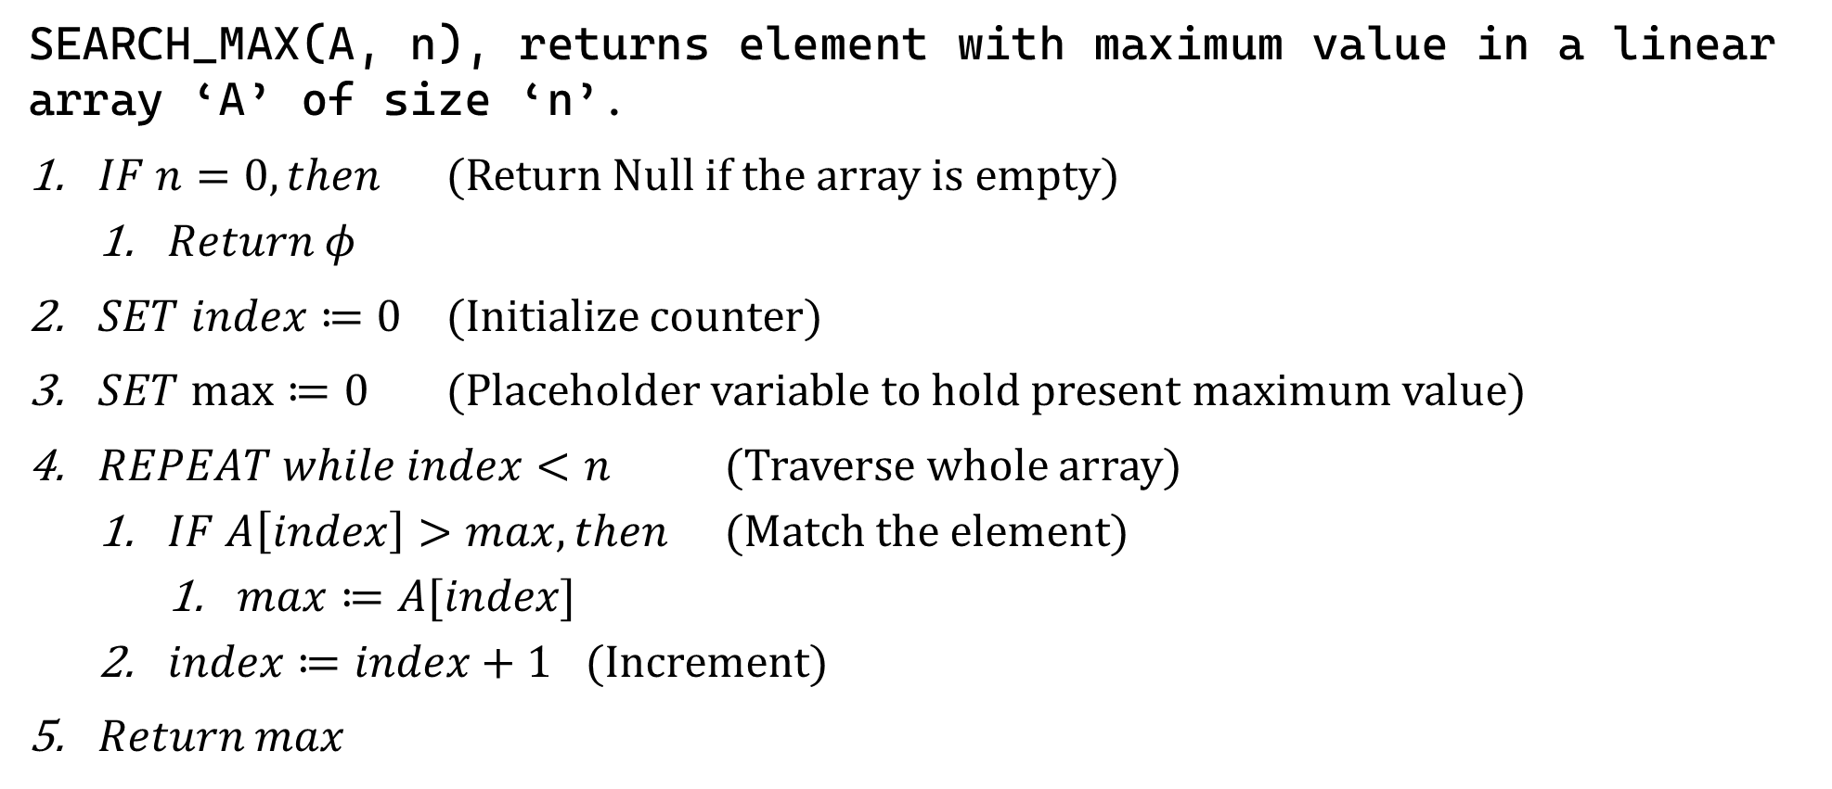
Sample 2
Array operations – Search for Maximum value
SEARCH_MAX(A, n), returns element with maximum value in a linear array ‘A’ of size ‘n’.
$IF n=0, then$ (Return Null if the array is empty)
$Return φ$
$SET index≔0$ (Initialize counter)
$SET max≔0$ (Placeholder variable to hold present maximum value)
$REPEAT while index<n$ (Traverse whole array)
$IF A\left[index\right]>max, then$ (Match the element)
$max≔A[index]$
$index≔index+1$ (Increment)
$Return max$
Notes:
Demonstrate how to return maximum GPA

Slide 20
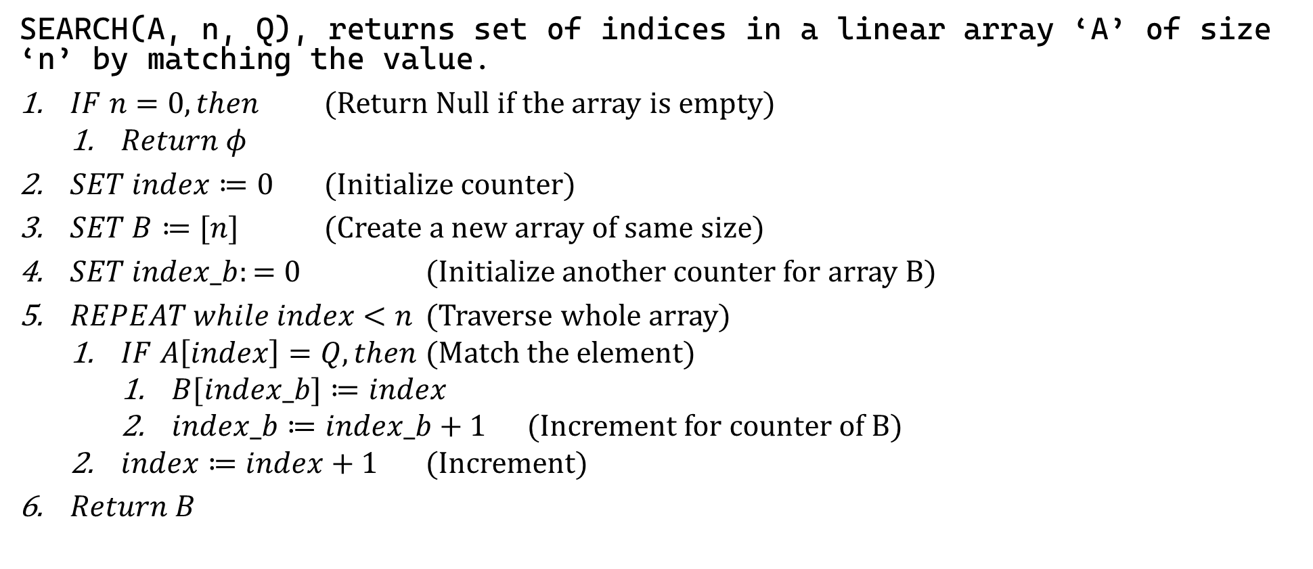
Sample 2
Array operations – Search for sub-set
SEARCH(A, n, Q), returns set of indices in a linear array ‘A’ of size ‘n’ by matching the value.
$IF n=0, then$ (Return Null if the array is empty)
$Return φ$
$SET index≔0$ (Initialize counter)
$SET B≔[n]$ (Create a new array of same size)
$SET index_b:=0$ (Initialize another counter for array B)
$REPEAT while index<n$ (Traverse whole array)
$IF A\left[index\right]=Q, then$ (Match the element)
$B[index_b]≔index$
$index_b≔index_b+1$ (Increment for counter of B)
$index≔index+1$ (Increment)
$Return B$
Notes:
Demonstrate how to search for all students with GPA 3.0 or higher. Take two equal arrays in example. One for student names and the other for GPAs

Slide 21
Sample 2
Array operations – Split
Split operation divides an array at a given index.
This function has several applications, one of them is table partitioning in databases.
We will see more applications in divide and conquer algorithms ahead.

Slide 22
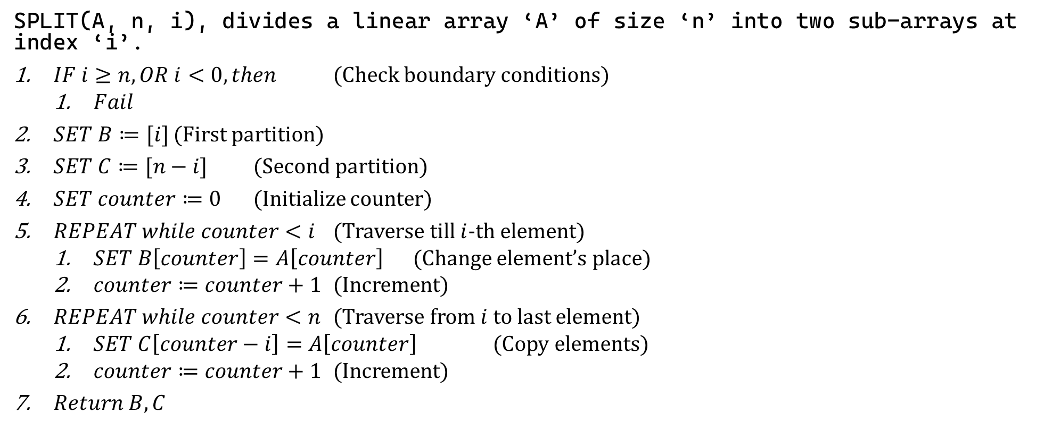
Sample 2
Array operations – Split
SPLIT(A, n, i), divides a linear array ‘A’ of size ‘n’ into two sub-arrays at index ‘i’.
$IF i≥n, OR i<0, then$ (Check boundary conditions)
$Fail$
$SET B≔[i]$ (First partition)
$SET C≔[n−i]$ (Second partition)
$SET counter≔0$ (Initialize counter)
$REPEAT while counter<i$ (Traverse till $i$-th element)
$SET B\left[counter\right]=A\left[counter\right]$ (Change element’s place)
$counter≔counter+1$ (Increment)
$REPEAT while counter<n$ (Traverse from $i$ to last element)
$SET C\left[counter−i\right]=A\left[counter\right]$ (Copy elements)
$counter≔counter+1$ (Increment)
$Return B, C$
Notes:
Demonstrate how 10 students can be split into two equal groups

Slide 23
Sample 2
Array operations – Merge
Merge operation combines two arrays by attaching second array right after the first one.
One of the most frequent usages of merge operation is union function in databases where results from two tables (with same structure but different data) are joined into a single table.

Slide 24
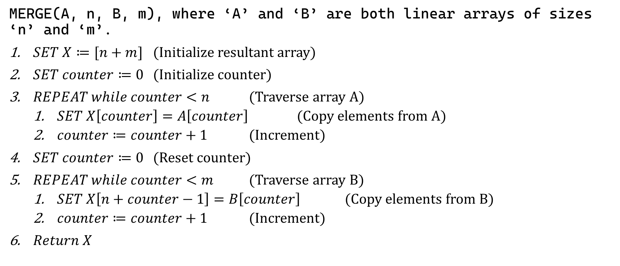
Sample 2
Array operations – Merge
MERGE(A, n, B, m), where ‘A’ and ‘B’ are both linear arrays of sizes ‘n’ and ‘m’.
$SET X≔[n+m]$ (Initialize resultant array)
$SET counter≔0$ (Initialize counter)
$REPEAT while counter<n$ (Traverse array A)
$SET X\left[counter\right]=A\left[counter\right]$ (Copy elements from A)
$counter≔counter+1$ (Increment)
$SET counter≔0$ (Reset counter)
$REPEAT while counter<m$ (Traverse array B)
$SET X\left[n+counter−1\right]=B\left[counter\right]$ (Copy elements from B)
$counter≔counter+1$ (Increment)
$Return X$

Slide 25
Sample 2
Array operations – Expand
Expand operation adds new memory blocks to an array.
Since it is not possible to dynamically increase size of an array, therefore we create a new array of larger size and copy the elements from original array into the new one.
Can you write the Pseudocode for this operation?
EXPAND(A, n, m), where ‘A’ is a linear array of size ‘n’ and ‘m’ is the additional size to add to the existing array.

Slide 26
Sample 2
Multi-dimensional Arrays
Recalling the first example. The table is an array of arrays because each room has an array of seats and the set of all rooms itself is an array
 | ROOM
Seat | 1 | 2 | 3 | 4 | 5 | 6 | 7 | 8
1 | Ali | Sidra | Parkash | Azfar | Shahid | Owais | Rafeeq | Nabeeel
2 | Haseeb | Ashfaq | Ayesha | Moiz | Hamza | Hira | Umair | Ahmed
3 | Nabeel | Uzair | Khalid | Maimoona | Humdiya | Shakeeb | Abdullah | Babar
4 | Irtiza | Shamsher | Iqbal | Seema | Mughees | Irfan | Asifa | Haris
5 | Wasim | Kanwal | Saqib | Joseph | Shariq | Adnan | Sadeeqa | Amjad
6 | Robia | Haris | Daniyal | Khurram | Shujaat | Sumeet | Naseem
7 | Talha | Shahzeb | Hareem | Ather | Affan | Tahira | Tahir
8 |  | Noman | Jehan | Safwan | Omar |  | Rabia
9 |  | Waqas |  | Sana | Andre |  | Tariq
10 |  | Sajida

Slide 27
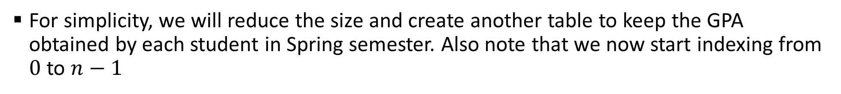
Sample 2
Multi-dimensional Arrays
For simplicity, we will reduce the size and create another table to keep the GPA obtained by each student in Spring semester. Also note that we now start indexing from $0$ to $n−1$
 | Column
Row | 0 | 1 | 2 | 3
0 | Ali | Sidra | Parkash | Azfar
1 | Nabeel | Uzair | Khalid | Maimoona
2 | Irtiza | Shamsher | Iqbal | Seema
3 | Wasim | Kanwal | Saqib | Joseph
4 | Talha | Shahzeb | Hareem | Ather
5 |  | Noman | Jehan | Safwan
6 |  | Waqas |  | Sana
7 |  | Sajida
 | Column
Row | 0 | 1 | 2 | 3
0 | 2.8 | 3.0 | 3.7 | 3.6
1 | 2.6 | 3.5 | 2.8 | 3.0
2 | 3.6 | 2.9 | 1.8 | 2.5
3 | 3.7 | 1.9 | 3.0 | 2.6
4 | 2.1 | 3.8 | 2.4 | 1.9
5 |  | 2.7 | 1.9 | 3.4
6 |  | 3.4 |  | 2.9
7 |  | 3.7

Slide 28
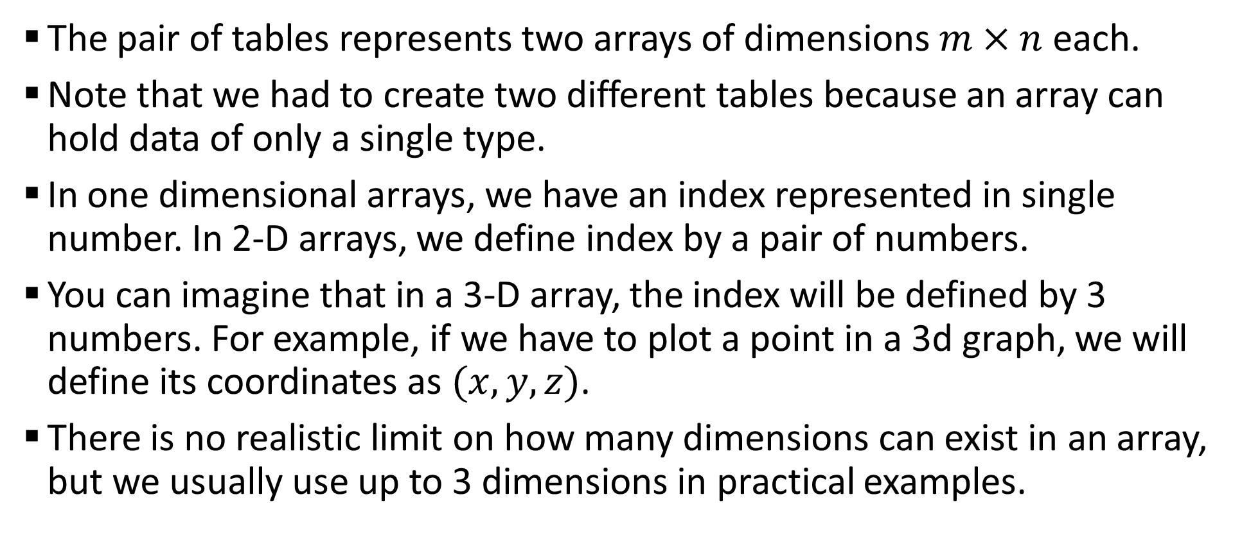
Sample 2
Multi-dimensional Arrays
The pair of tables represents two arrays of dimensions $m×n$ each.
Note that we had to create two different tables because an array can hold data of only a single type.
In one dimensional arrays, we have an index represented in single number. In 2-D arrays, we define index by a pair of numbers.
You can imagine that in a 3-D array, the index will be defined by 3 numbers. For example, if we have to plot a point in a 3d graph, we will define its coordinates as $(x,y,z)$.
There is no realistic limit on how many dimensions can exist in an array, but we usually use up to 3 dimensions in practical examples.

Slide 29
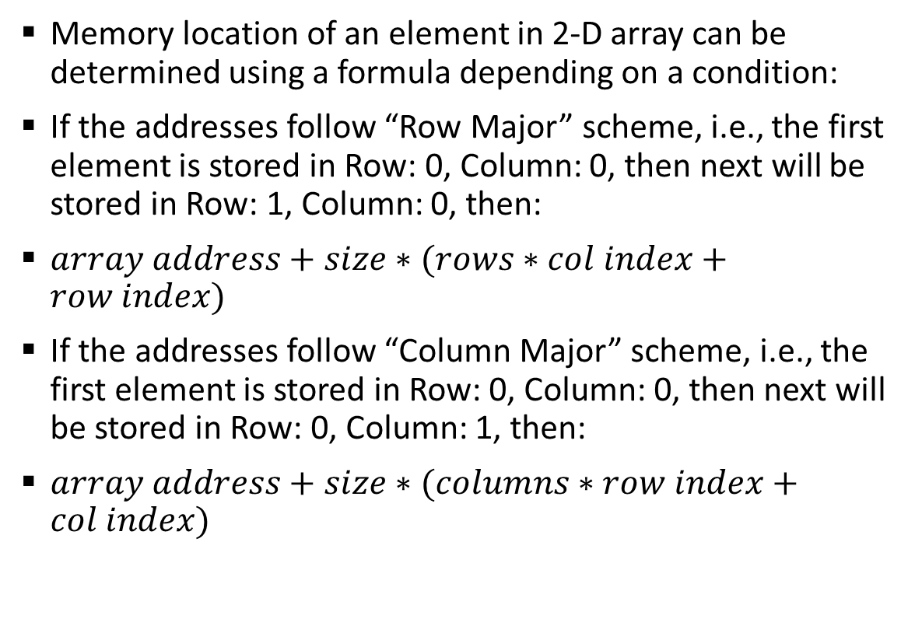
Sample 2
Multi-dimensional Arrays
Memory location of an element in 2-D array can be determined using a formula depending on a condition:
If the addresses follow “Row Major” scheme, i.e., the first element is stored in Row: 0, Column: 0, then next will be stored in Row: 1, Column: 0, then:
$array address+size∗(rows∗col index+row index)$
If the addresses follow “Column Major” scheme, i.e., the first element is stored in Row: 0, Column: 0, then next will be stored in Row: 0, Column: 1, then:
$array address+size∗(columns∗row index+col index)$
 | Column
Row | 0 | 1 | 2 | 3
0 | 2.8 | 3.0 | 3.7 | 3.6
1 | 2.6 | 3.5 | 2.8 | 3.0
2 | 3.6 | 2.9 | 1.8 | 2.5
3 | 3.7 | 1.9 | 3.0 | 2.6
4 | 2.1 | 3.8 | 2.4 | 1.9
5 |  | 2.7 | 1.9 | 3.4
6 |  | 3.4 | 2.5 | 2.9
7 |  | 3.7 | 1.8

Slide 30
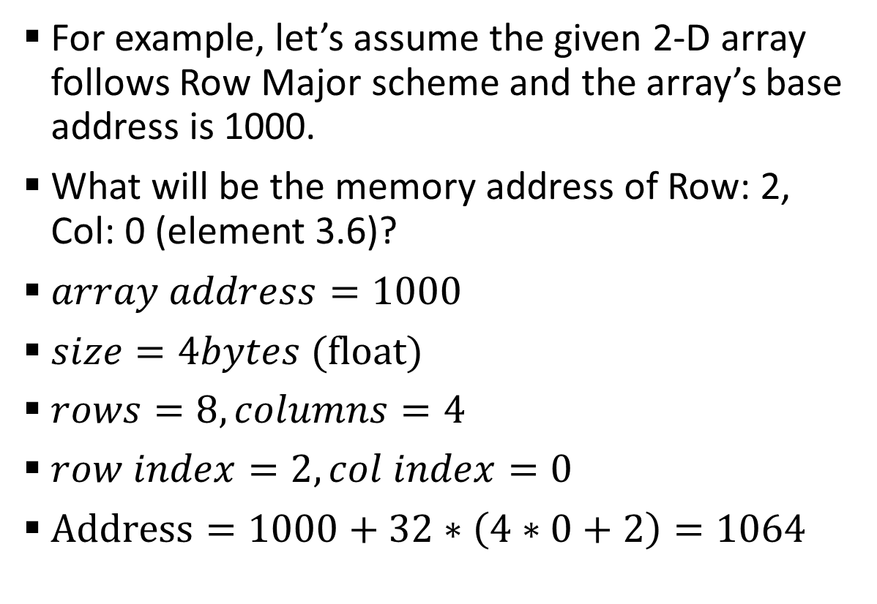
Sample 2
Multi-dimensional Arrays
For example, let’s assume the given 2-D array follows Row Major scheme and the array’s base address is 1000.
What will be the memory address of Row: 2, Col: 0 (element 3.6)?
$array address=1000$
$size=4bytes$ (float)
$rows=8,columns=4$
$row index=2,col index=0$
$Address=1000+32∗\left(4∗0+2\right)=1064$
 | Column
Row | 0 | 1 | 2 | 3
0 | 2.8 | 3.0 | 3.7 | 3.6
1 | 2.6 | 3.5 | 2.8 | 3.0
2 | 3.6 | 2.9 | 1.8 | 2.5
3 | 3.7 | 1.9 | 3.0 | 2.6
4 | 2.1 | 3.8 | 2.4 | 1.9
5 |  | 2.7 | 1.9 | 3.4
6 |  | 3.4 | 2.5 | 2.9
7 |  | 3.7 | 1.8

Slide 31
Sample 2
Exercise
For example, let’s assume the given 2-D array follows Column Major scheme and the array’s base address is 1000.
What will be the memory addresses of:
Row: 2, Col: 0 (element 3.6)?
Row: 4, Col: 3 (element 1.9)?
 | Column
Row | 0 | 1 | 2 | 3
0 | 2.8 | 3.0 | 3.7 | 3.6
1 | 2.6 | 3.5 | 2.8 | 3.0
2 | 3.6 | 2.9 | 1.8 | 2.5
3 | 3.7 | 1.9 | 3.0 | 2.6
4 | 2.1 | 3.8 | 2.4 | 1.9
5 |  | 2.7 | 1.9 | 3.4
6 |  | 3.4 | 2.5 | 2.9
7 |  | 3.7 | 1.8

Slide 32
Sample 2
Record Keeping using Arrays
A record is a set of one or more values related to a single entity. For example, a student’s record may look like:
Name: Abdul Mohimin
SID: 5040
CGPA: 2.8
Suppose you have a list of students in a class with their respective Name, SID and CGPA. How can this information be represented in arrays?
You will need 3 different arrays. First, because the data type is different and secondly, because these are separate pieces of data.
All 3 arrays should be controlled by single index. For example, if you delete and element from first array, then consecutive elements should be deleted from other arrays as well.

Slide 33
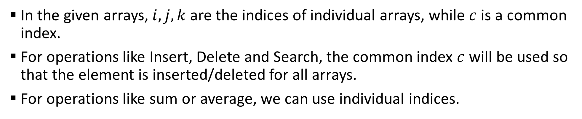

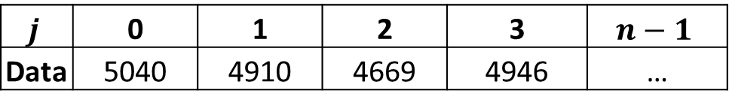
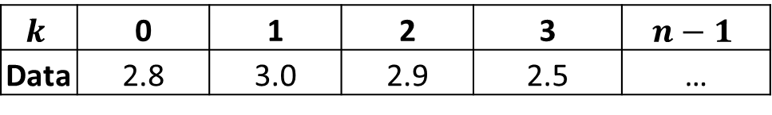
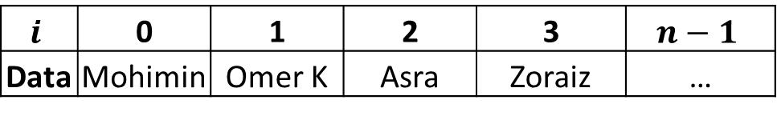
Sample 2
Record Keeping using Arrays
In the given arrays, $i,j,k$ are the indices of individual arrays, while $c$ is a common index.
For operations like Insert, Delete and Search, the common index $c$ will be used so that the element is inserted/deleted for all arrays.
For operations like sum or average, we can use individual indices.
$$i$$ | 0 | 1 | 2 | 3 | $$n−1$$
Data | Mohimin | Omer K | Asra | Zoraiz | …
$$c$$
$$j$$ | 0 | 1 | 2 | 3 | $$n−1$$
Data | 5040 | 4910 | 4669 | 4946 | …
$$k$$ | 0 | 1 | 2 | 3 | $$n−1$$
Data | 2.8 | 3.0 | 2.9 | 2.5 | …

Slide 34
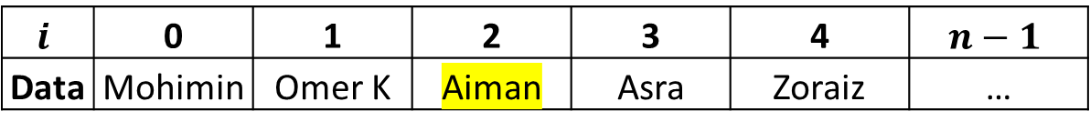

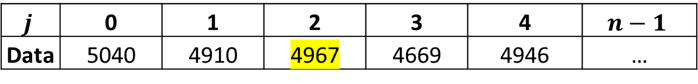
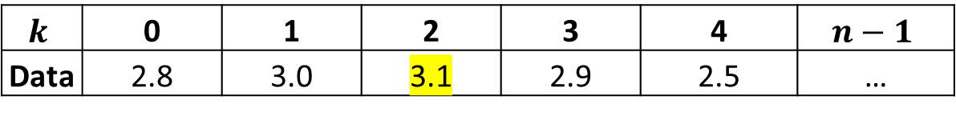
Sample 2
Record Keeping using Arrays
E.g., to Insert another record Aiman at index 2. We will need to move “Records” from index 2 onwards.
However, this will be done for all 3 arrays simultaneously.
But what if you did not have the CGPA information?
$$i$$ | 0 | 1 | 2 | 3 | 4 | $$n−1$$
Data | Mohimin | Omer K | Aiman | Asra | Zoraiz | …
$$c$$
$$j$$ | 0 | 1 | 2 | 3 | 4 | $$n−1$$
Data | 5040 | 4910 | 4967 | 4669 | 4946 | …
$$k$$ | 0 | 1 | 2 | 3 | 4 | $$n−1$$
Data | 2.8 | 3.0 | 3.1 | 2.9 | 2.5 | …

Slide 35
Sample 2
Exercise
Can you modify the Pseudocode of INSERT operation to enter a record instead of only one value?
Tips!
See if the input parameters need to change.
Make sure that the operation either completes successfully or fails entirely. Half operation should not be allowed.

Slide 36
Sample 2
DIY
Problems for practice:
Q4.22
Q4.25 (Programming exercise)
Write the Pseudocode for the following operations in a 2-D array:
INSERT
TRAVERSE
DELETE
Hint! You should think about modifying the Pseudocodes of 1-D arrays.

Slide 37



THANK YOU
Owais Hussain
+92 345-3174270
owais.hussain@kiet.edu.pk
https://www.researchgate.net/profile/Owais-Hussain-3

